Slide 1
Web Assembly
In .NET with Blazor
James Ekstrom
james@jamesekstrom.com

Slide 2
What is Web Assembly?

Slide 3
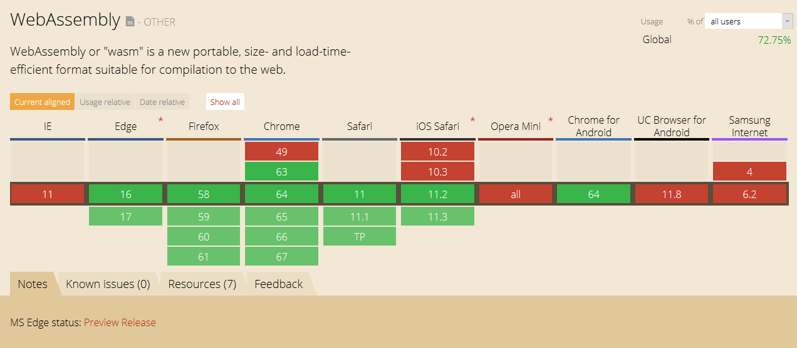
Binary standard for the web
Compile target
Faster than JavaScript
Supported in all major browsers
Pollyfilled with asm.js

Slide 4
What the blazes is Blazor?

Slide 5
Experimental project by Steve Sanderson of Microsoft
SPA framework built in .NET that runs in the browser (like Vue.js, Angular, react, etc.)
Built on Razor, Mono with .NET Standard support
Provides routing, dependency injection, layouts, lazy loading
Interop with JavaScript
Puts .NET on the bleeding edge of Web tech, instead of trailing behind
Open source

Slide 6
How does it work
Mono is compiled into wasm and asm.js (polyfil) using emscripten (LLVM->wasm compiler)
Blazor libraries compile Razor components into a .NET assembly (against .NET standard 2.0)
Assemblies and Mono wasm are packaged into /dist
Browser loads Mono wasm. Mono loads .NET .dlls.
Your .NET app runs in the browser natively!

Slide 7
Wait, what was that about Mono?

Slide 8

Mono is a fully supported Microsoft product (since Xamarin acquisition, 2016)
For “client” applications (cross-platform support)
mono-wasm generates wasm given .NET IL
Blazor runs in Mono, which is compiled to wasm separately
Work in progress to remove emscripten and binaryen dependencies and compile directly to LLVM with clang and lld to generate wasm

Slide 9
Demo

Slide 10
Questions?
James Ekstrom
james@jamesekstrom.com

